Slide 1



EU Lifelong Learning Programme, KA4 project
Dissemination and Exploitation via Libraries – for Success and Sustainability of LLP Results
November 2012 – October 2014
Social Innovation Fund, Lithuania
531194-LLP-2012-LV-KA4-KA4MP

Slide 2

Background information about Life Long Learning Programme 2007-2013
As the flagship European Funding programme in the field of education and training, the Lifelong Learning Programme (LLP) enables individuals at all stages of their lives to pursue stimulating learning opportunities across Europe. It is an umbrella programme integrating various educational and training initiatives. LLP is divided in four sectorial sub programmes and four so called 'transversal' programmes.
The Education, Audiovisual and Culture Agency Executive Agency (EACEA) is responsible for the management of certain parts of the Lifelong learning programme under supervision from its parent Directorate-General for Education and Culture (DG EAC).

Slide 3

Sectorial sub programmes of LLP programme
The sectorial sub programmes focus on different stages of education and training and continuing previous programmes:
Comenius for schools
Erasmus for higher education
Leonardo da Vinci for vocational education and training
Grundtvig for adult education

Slide 4

The transversal programmes of LLP programme
The transversal programmes aim to complement the sectorial sub programmes and to ensure that they achieve the best results possible. They aim to promote European cooperation in fields covering two or more of the sub-programmes. In addition they seek to promote quality and transparency of Member States' education and training systems.
Four key activities focus on:
Policy cooperation and innovation
Languages
Information and communication technologies - ICT
Dissemination and exploitation of results

Slide 5
Other programmes of LLP programme
The Jean Monnet programme also falls under the LLP umbrella, in addition to the sectorial and transversal programmes, The Jean Monnet programme stimulates teaching, reflection and debate on the European integration process at higher education institutions.
Eurydice is an institutional network for gathering, monitoring, processing and circulating reliable and readily comparable information on education systems and policies throughout Europe. Although it forms part of the LLP transversal programmes, Eurydice does not provide financial support or fund projects. Eurydice is a Network consisting of a European Unit and National Units. The European Units are funded by the European Commission, while the National Units are funded by the governments that establish them. They may also receive financial support from the European Commission.

Slide 6
The main life stages of LLP projects
Each LLP project has few main life stages:
Management
Development
Evaluation/quality assurance
Valorization= dissemination and exploitation
'Valorisation' is the French equivalent term for 'dissemination and exploitation of results'.
The two terms are sometimes used interchangeably in English in the context of the EU Lifelong Learning Programme and its predecessors.

Slide 7
Concepts of Dissemination & Exploitation
What is the rationale for the dissemination and exploitation of results?
Systematic dissemination and exploitation of results are crutial helping to maximise the impact of activities undertaken within the project.
Benefits of the effective valorisation strategy are the followings:
improving the sustainability of project results, in line with end-user needs
generating savings by exploiting existing practices (means no ‘re-inventing the wheel’)
transferring results in order to transform systems and practices, thus enhancing the impact of EU-funded programmes and projects at systems level
reducing time-scales for policy and process innovation
feeding the policy process (peer learning, Open Method of Coordination)

Slide 8
What is meant by "dissemination and exploitation of the project’s results"?
'Dissemination and exploitation of results' refers to activities designed to ensure that the results of the LLP are appropriately recognised, demonstrated and implemented on a wide scale. Within the context of the LLP, the following distinctions should be observed:
Dissemination: Derived from the Latin for "abroad" (dis) and "seed" (semin), to disseminate simply means to “spread widely”. And that is precisely what disseminating your project results is all about: spreading them far and wide. This is defined as a planned process of providing information of the results of the Project to key actors. It occurs as and when the results of the Project become available.
Within Di-XL Project we would like to promote the libraries as one of the important key actor for dissemination at NATIONAL level.

Slide 9
Exploitation =mainstreaming & multiplication
Exploitation consists of 'mainstreaming' and 'multiplication'. 'Mainstreaming' is the planned process of transferring the successful results of the Project to appropriate decision-makers in local, regional, national or European level. Multiplication is the planned process of convincing individual end-users to adopt and/or apply the results of the Project.
The exploitation is mainly the task of the project‘s partners, however, libraries could become a valuable partners in the exploitations stage too.
'Dissemination' and 'exploitation' are therefore distinct concepts, but closely related to one another. The keys to a successful exploitation of results are:
producing relevant results from projects to satisfy the demands of providers, policy-makers and ultimately society more generally;
ensuring, through the use of effective dissemination and exploitation, that such results reach the right target audiences in a format and at a time which enables them to benefit from them.
Within the Di-XL project the partners are working on the methodology to make the Libraries one of the main successful key factors for dissemination and exploitation.

Slide 10
The dissemination toolkit is a large one. The mechanisms available to spread the output of a project are numerous.
The most popular are printed materials, DVD and web-sites.
Print publications and DVD are a popular dissemination tool. Most of the project managers keep a mailing list – both postal and electronic – containing a list of recipients who are interested in the project, such as policy-makers, civil society organisations, sectorial bodies, educational institutions, academics and students.
Within Di-XL project we try to find out the way of making the printed materials and DVD easier-accessible for the customers in the libraries.
In this case each printed material and DVD have to have the ISBN number.

Slide 11

Websites of the projects are powerful tools for reaching your target audience and promoting your project. Project managers use their websites to provide information about the project and news of its activities and finally results.
With billions of webpages floating around in cyberspace, one of the main challenges for dissemination of the projects results via websites is ensuring that they are visited by the target audience. This means that, although websites are dissemination tools, it is not just enough simply to put them on-line, but they also need to be actively promoted and publicised.
Within Di-XL project we suggest to disseminate the projects’ websites via libraries by making the banners with the databases of the LLP projects titles and their web-sites available in the first page of the library web-site

Slide 12
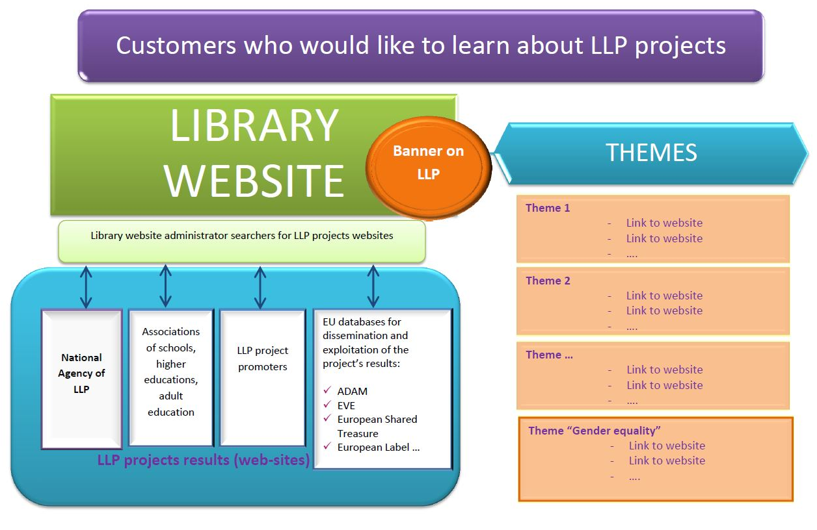
Dissemination tool –
Promoting of LLP projects’ websites via libraries

